Slide 1
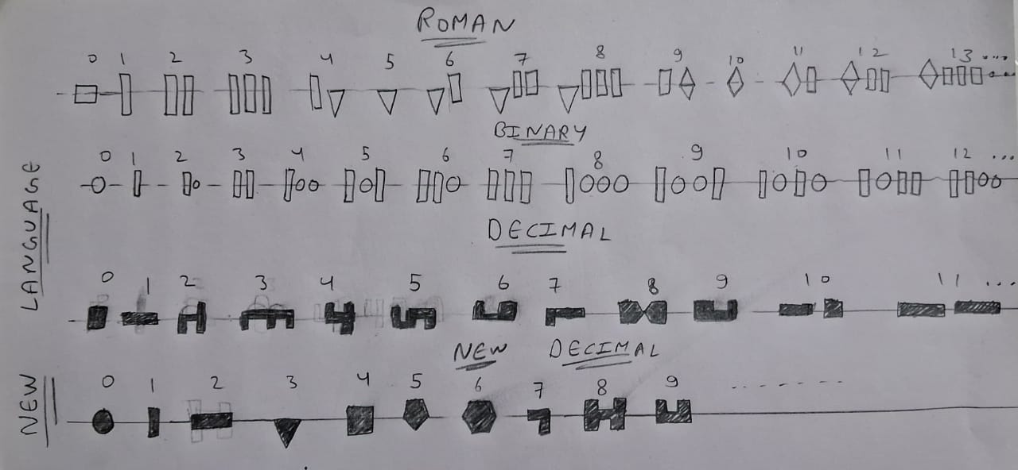
THE LANGUAGE OF UNIVERSE

Slide 2
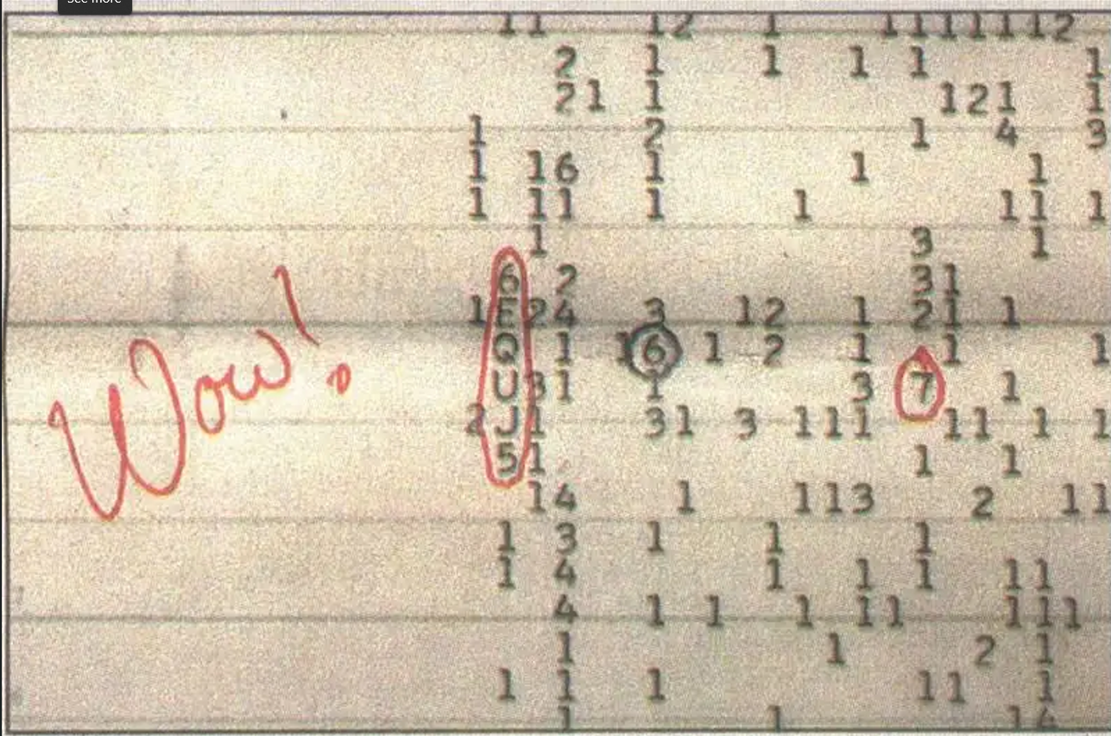

Slide 3
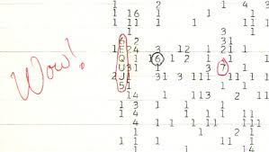
WOW
The Wow! Signal (August 15, 1977)
Detection:
Observed by Ohio State’s Big Ear radio telescope near Sagittarius
Frequency: ~1420 MHz (close to the hydrogen line)
Signal Details:
Duration: 72 seconds
Intensity noted as “6EQUJ5” (with “U” ~30× background noise)
Notable Moment:
Astronomer Jerry Ehman circled the signal and scribbled “Wow!” on the printout

Slide 4
Controversies & Theories
.Possible extraterrestrial transmission, but unconfirmed.
.May be a rare astrophysical event (e.g., magnetar burst, .hydrogen cloud collision).
.Comet hypothesis proposed but widely disputed.
.Earth-based interference? Unlikely due to protected .
frequency.
Decoding the Signal
.“6EQUJ5” represents signal strength over time, not a
hidden message.
The Real Truth
.Never detected again → No definitive conclusion.
.Could be alien or natural, but remains one of SETI’s
biggest mysteries.

Slide 5
UNIVERSAL LANGUAGE

Slide 6
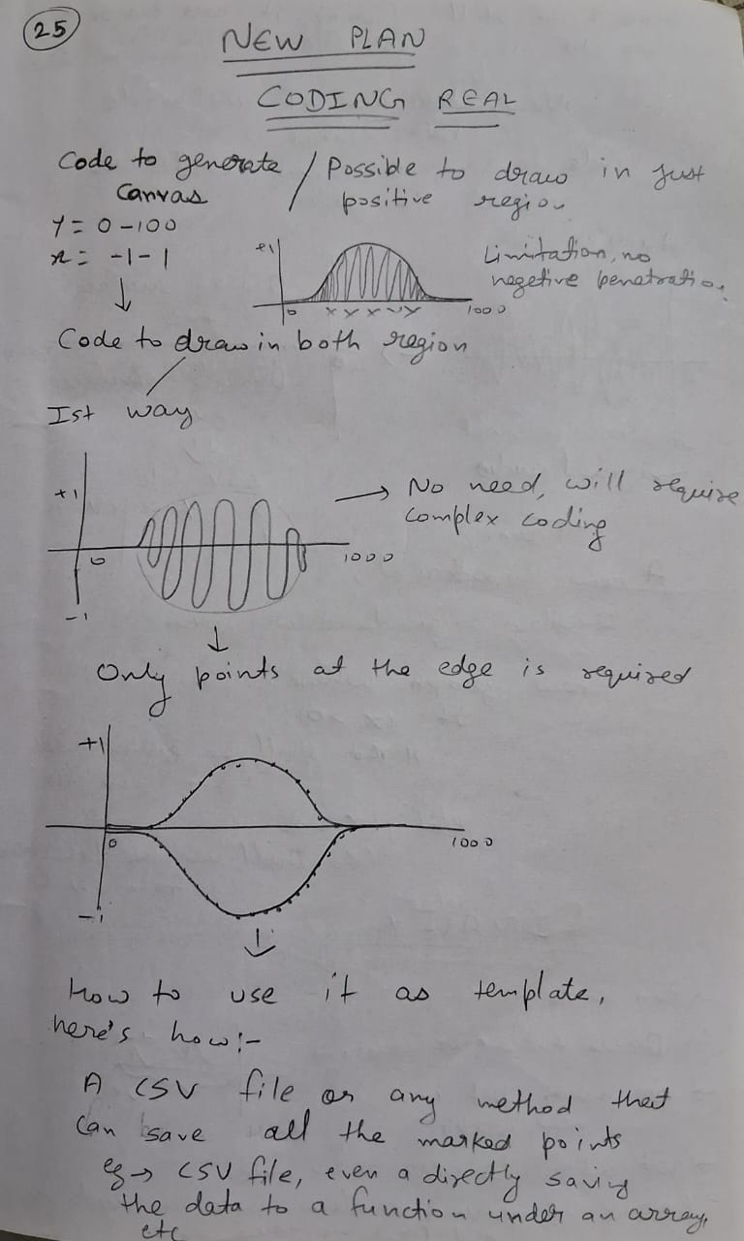
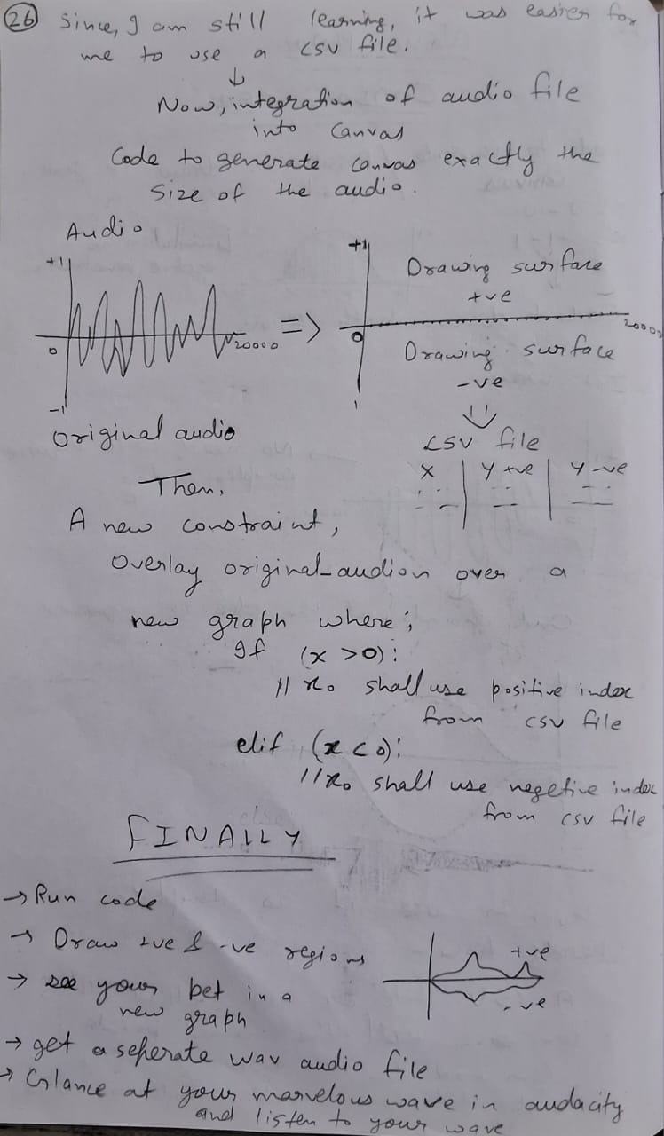
Communication Medium

Slide 7
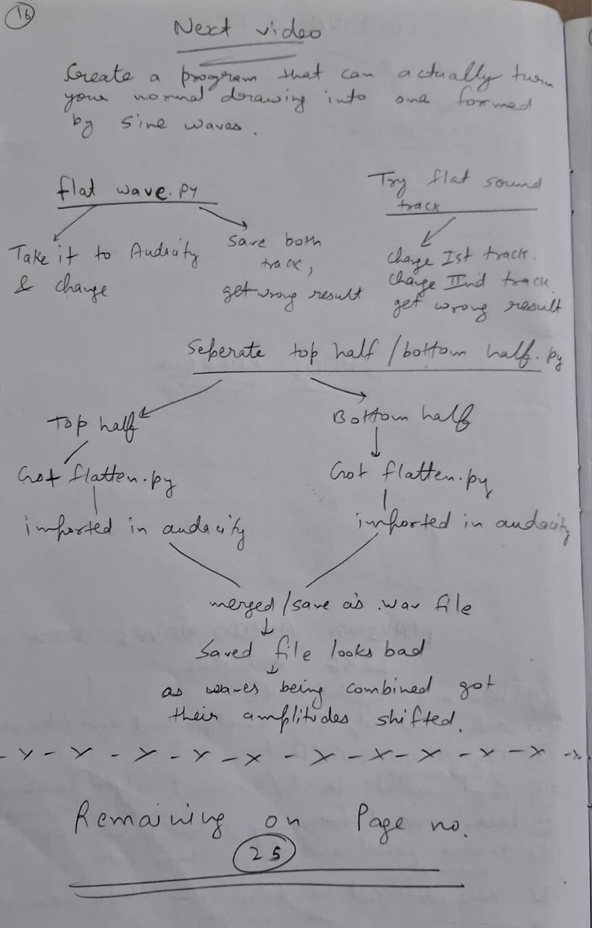
Code Plan
Run code.
input a audio fileGet a drawing canvas (graphical matplotlib ) window pop-up.
draw your desired shape on the canvas.
close the canvas windownow plot with original and future_original plot will open.
close the plot windowenjoy your new created file with .csv, .png, .wav file.

Slide 8

OPEN SOURCE CODE
Here’s my repo if anyone interested. LINK : https://github.com/World-hackr/Natural_Communication.git

Slide 9
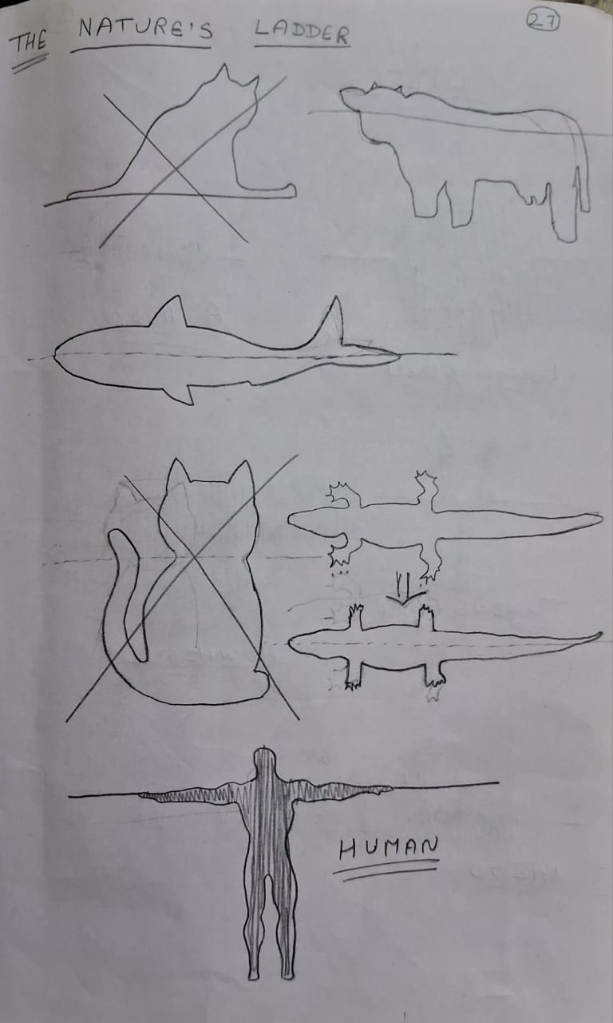
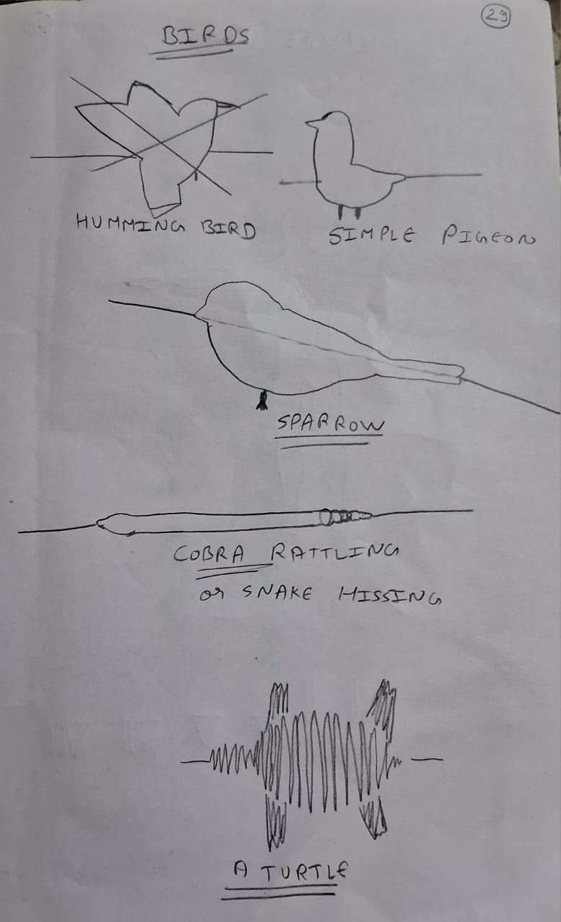
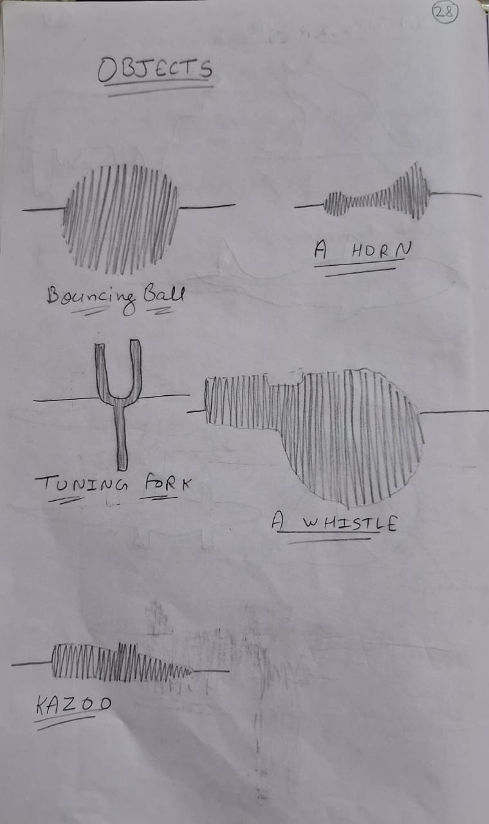
HIT & TRY (Most frustrating)

Slide 10
TEST EXAMPLES

